Slide 1

Preprocessing
Center for Health Data Science

Slide 2
Overview
File formats
Workflow overview
Library prep and seq technology
Trimming and filtering
Read alignment
Quality control
Read count tables

Slide 3
File formats
In bioinformatics we use a plethora of different file formats for different tools and analysis
UCSC Genome Browser provides a detailed description of main file formats and what they should contain
http://genome.ucsc.edu/FAQ/FAQformat
Notes:
UCSC: http://genome.ucsc.edu/FAQ/FAQformat

Slide 4
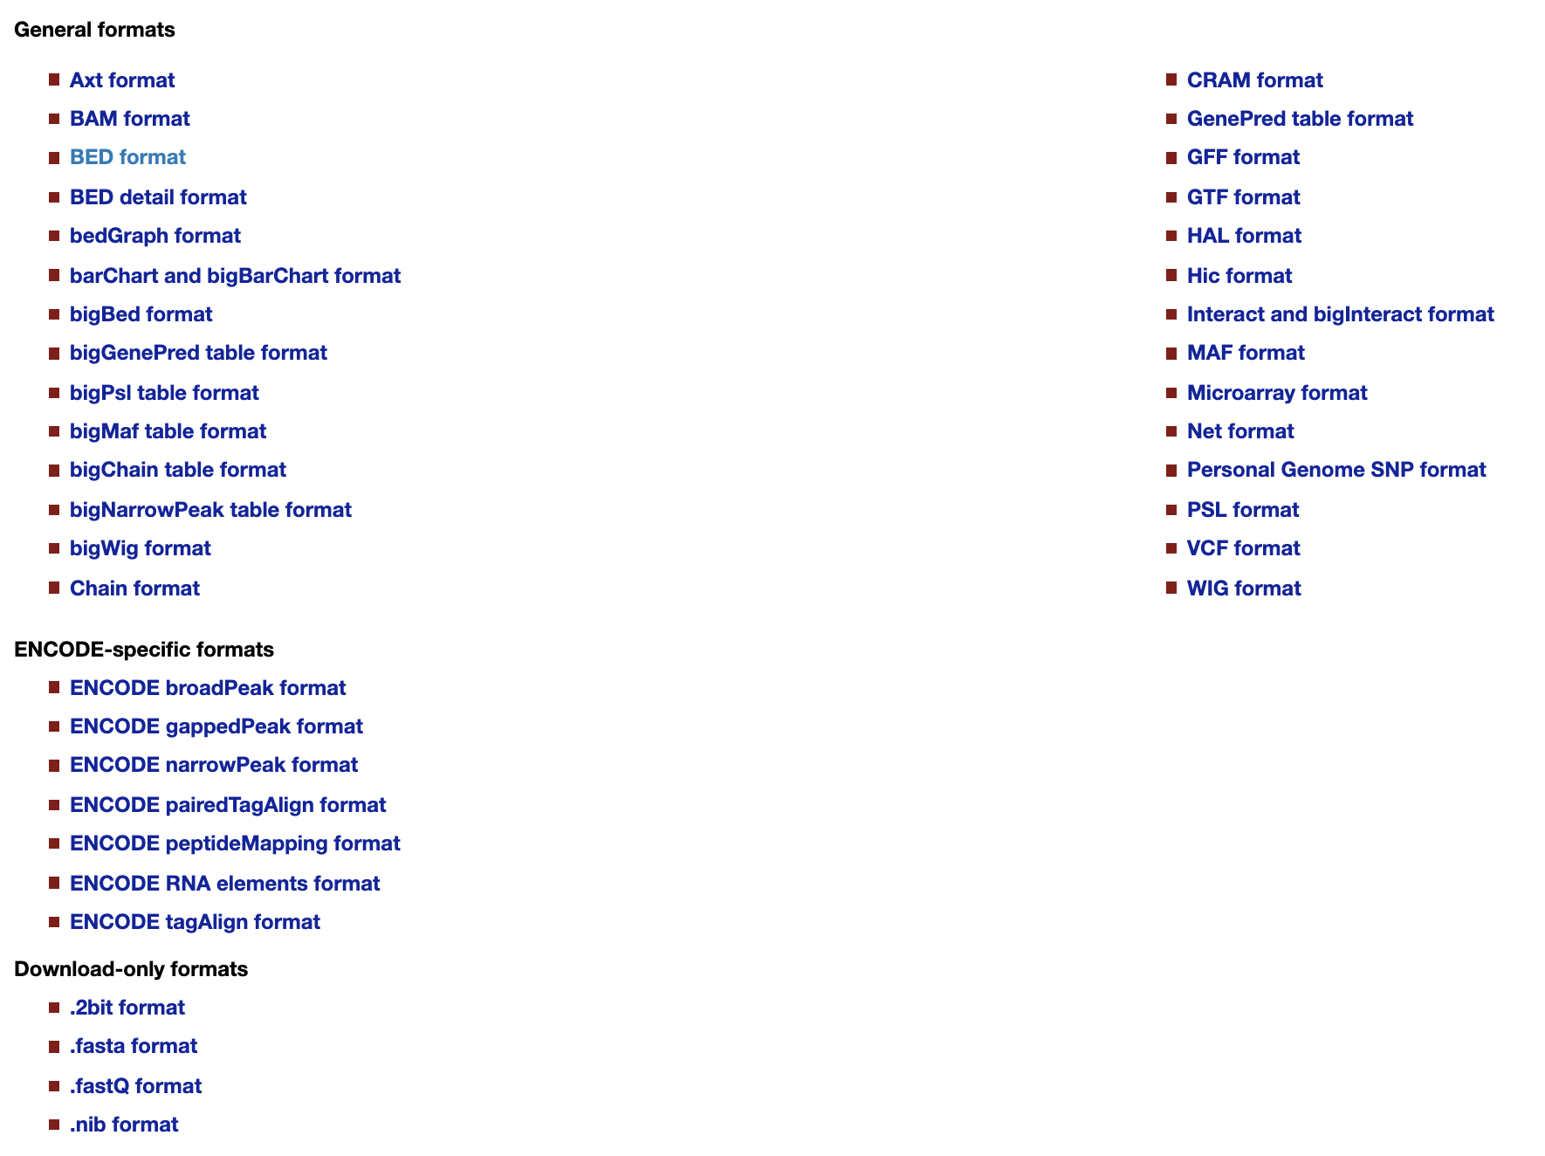
File formats
Today we will use ...
Alignment
Chromosome Regions
Reference
Reads
Annotation
Notes:
UCSC: http://genome.ucsc.edu/FAQ/FAQformat

Slide 5
Workflow
overview
counts table
Gene ID | Counts
Gene A | 5
Gene B | 3
Gene C | 9
Sequencer
Produce images
.tsv

Slide 6
Workflow
overview
counts table
Gene ID | Counts
Gene A | 5
Gene B | 3
Gene C | 9
Sequencer
Produce images
.tsv
CONVERT
to text files
TRIM
reads
ALIGN
to reference
REMOVE
duplicates*
QUANTIFY
reads per region
*might not always be recommended

Slide 7
Workflow
overview
counts table
Gene ID | Counts
Gene A | 5
Gene B | 3
Gene C | 9
.bcl
Sequencer
Produce images
.tsv

Slide 8
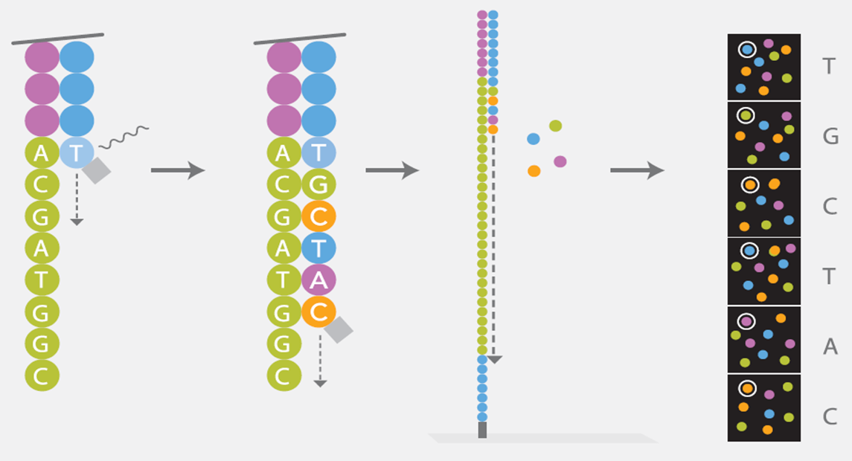
Sequencing by Synthesis

Slide 9
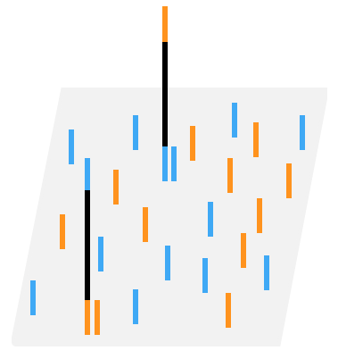
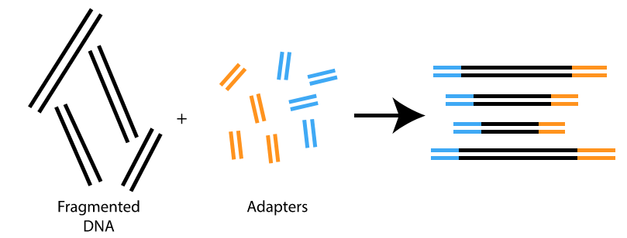
Sequencing by Synthesis
1. Shear target DNA into small pieces
2. bind individual DNA molecules to the surface of the flowcell

Slide 10
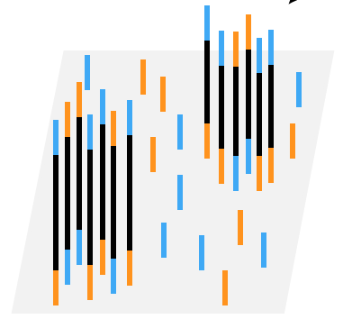
Sequencing by Synthesis
3. Amplify each molecule into a cluster with a PCR step (signal is tiny)
4. insert one base at a time and detect different signals for A, C, T, & G bases

Slide 11
Sequencing by Synthesis
Why you might read into the adapter

Slide 12
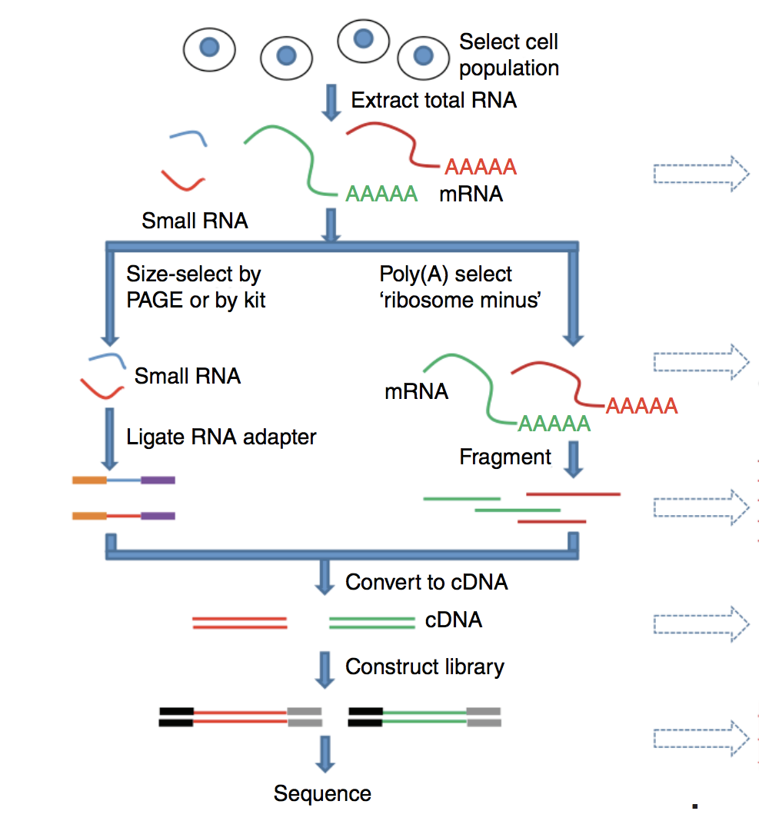
Input DNA
RNAseq library prep
Where does this input DNA come from?

Slide 13
Workflow
overview
counts table
Gene ID | Counts
Gene A | 5
Gene B | 3
Gene C | 9
.bcl
.fastq
@READ_ID
CCNGGNNNNTANNNCAAANAAN
+
AA#AA####EE###EEEE#EE#
Sequencer
Produce images
.tsv
CONVERT
to text files

Slide 14
A slide about how to get fastq files from bcl files? I thought that happens automatically in base space

Slide 15
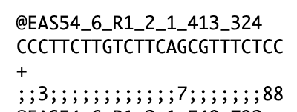
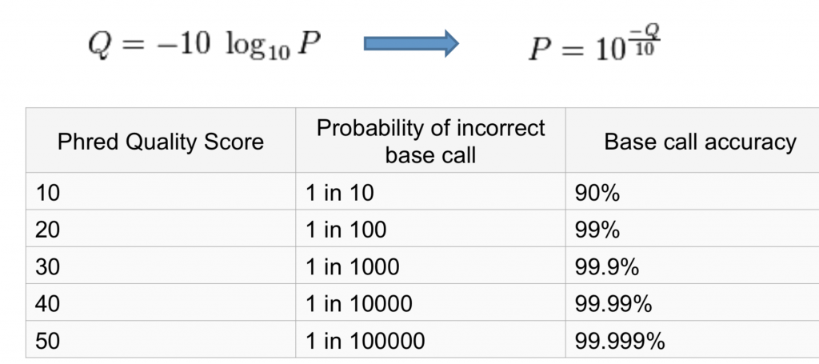
Fastq. Raw read file format
P = probability of wrong call
Contains
ID of the read. ID and description depends on technology
Sequence
Quality of each nucleotide (Phred score/quality)
We can use Phred score to filter low quality reads
Notes:
Phred Score: http://maq.sourceforge.net/qual.shtml
TrimGalore: https://www.bioinformatics.babraham.ac.uk/projects/trim_galore/
Phred score = A quality Q is an integer representation of the probability that the corresponding base is incorrect

Slide 16
Base Call Quality
Seq by synthesis reads one base at a time
Each of these bases has a probability of being wrongly called, i.e. the true base in the input DNA is not the one we get reported
We want to omit bases with a high probability of being wrong (more in next session)
Quality often decays along the read

Slide 17
Workflow
overview
counts table
.fastq
Remove:
Adapters
Low quality reads
Poly-A tails
.fastq
Gene ID | Counts
Gene A | 5
Gene B | 3
Gene C | 9
Sequencer
Produce images
cleaned
trimmed
reads
.tsv
”raw”
reads
CONVERT
to text files
TRIM
reads

Slide 18
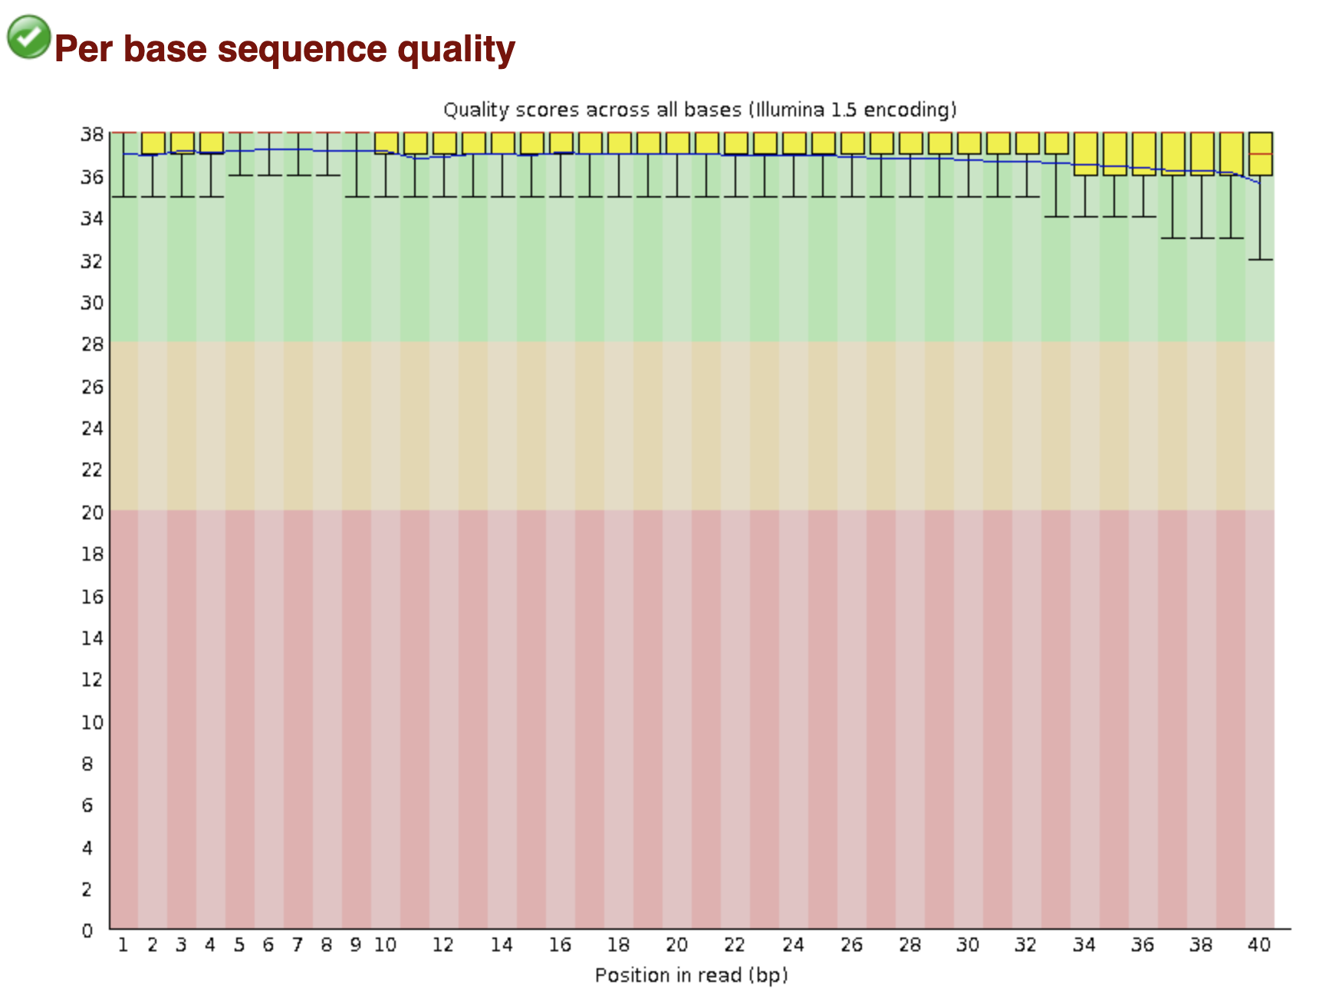
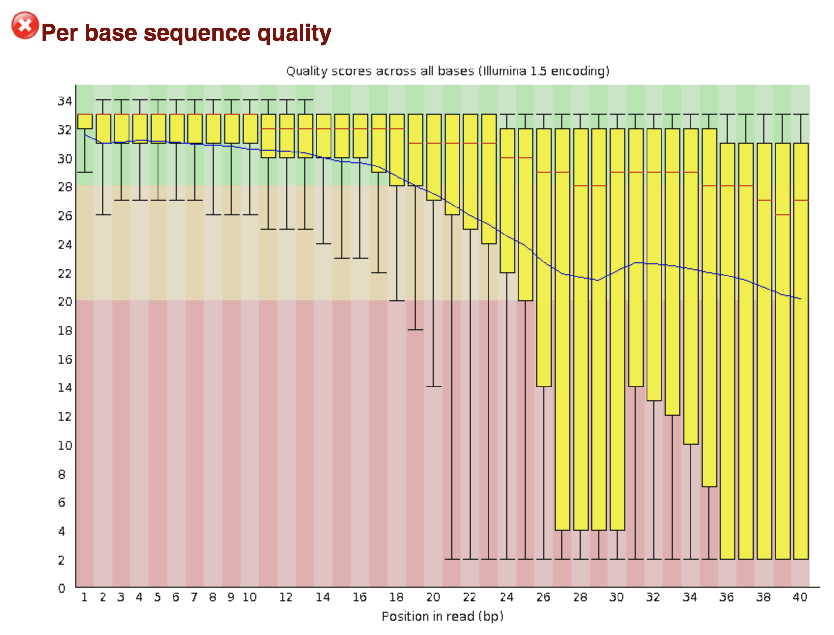
Quality Control. FastQC
Simple way to do some QC checks on raw sequence data
Basic statistics, sequence quality and GC content, duplications, etc
Notes:
fastQC: https://www.bioinformatics.babraham.ac.uk/projects/fastqc/
FastQC checks:
Basic Statistics
Per base sequence quality
Per tile sequence quality
Per sequence quality scores
Per base sequence content
Per sequence GC content
Per base N content
Sequence Length Distribution
Sequence Duplication Levels
Overrepresented sequences
Adapter Content

Slide 19
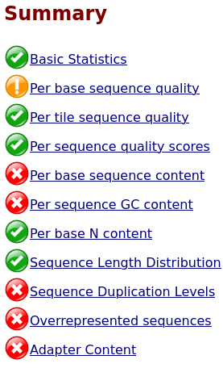

Quality Control. FastQC
A lot of modules!
Failed modules are not always a problem, it depends on what you have sequenced and your protocol
Documentation has info on
what each module checks
what will cause it to fail
common explanations for fails
Click this
Notes:
fastQC: https://www.bioinformatics.babraham.ac.uk/projects/fastqc/
FastQC checks:
Basic Statistics
Per base sequence quality
Per tile sequence quality
Per sequence quality scores
Per base sequence content
Per sequence GC content
Per base N content
Sequence Length Distribution
Sequence Duplication Levels
Overrepresented sequences
Adapter Content

Slide 20
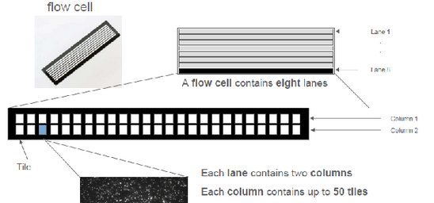
Quality Control. FastQC
Per tile sequence quality:
Illumina flowcells are made up of tiles.
Bad quality over several positions indicates a problem with the tile.
Notes:
fastQC: https://www.bioinformatics.babraham.ac.uk/projects/fastqc/
FastQC checks:
Basic Statistics
Per base sequence quality
Per tile sequence quality
Per sequence quality scores
Per base sequence content
Per sequence GC content
Per base N content
Sequence Length Distribution
Sequence Duplication Levels
Overrepresented sequences
Adapter Content

Slide 21
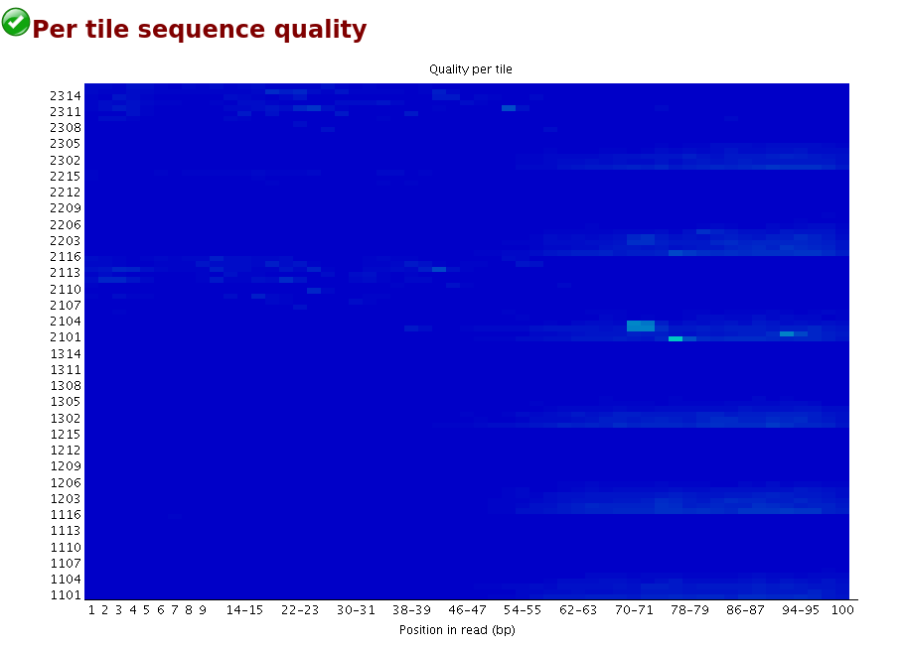
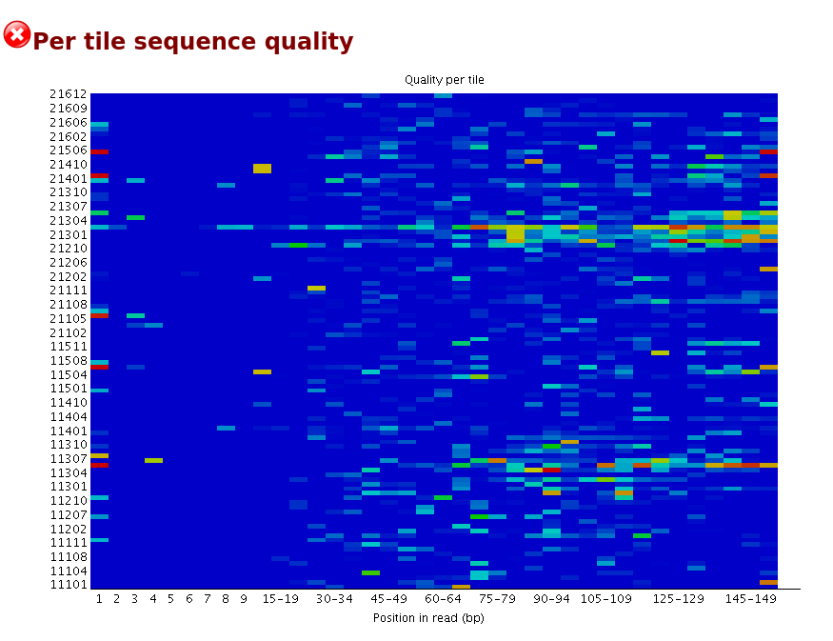
Quality Control. FastQC
Quality per tile: Bad quality over several positions indicates a problem with the tile.
Notes:
fastQC: https://www.bioinformatics.babraham.ac.uk/projects/fastqc/
FastQC checks:
Basic Statistics
Per base sequence quality
Per tile sequence quality
Per sequence quality scores
Per base sequence content
Per sequence GC content
Per base N content
Sequence Length Distribution
Sequence Duplication Levels
Overrepresented sequences
Adapter Content

Slide 22
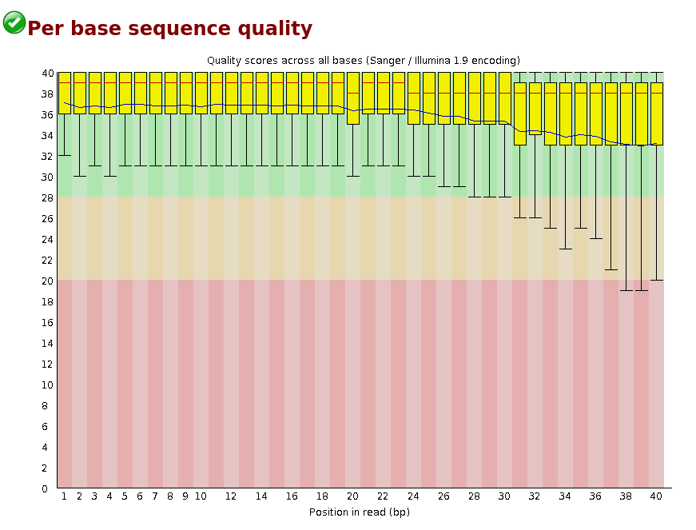
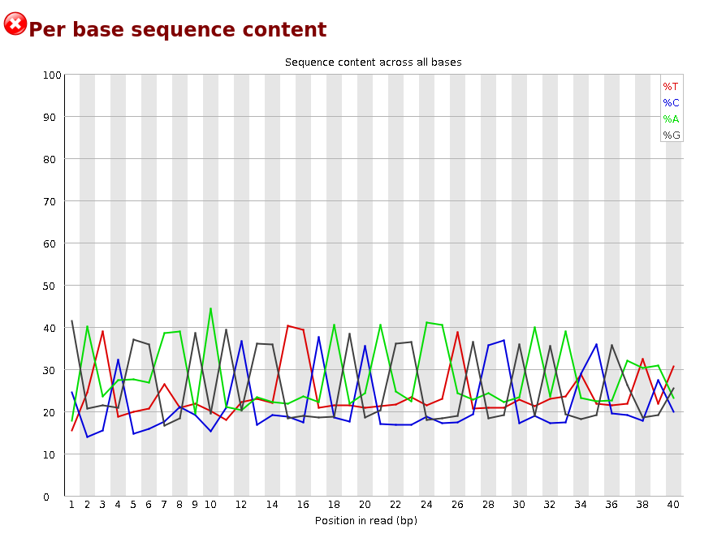
Quality Control. FastQC
An example: Primer dimers
Notes:
fastQC: https://www.bioinformatics.babraham.ac.uk/projects/fastqc/
FastQC checks:
Basic Statistics
Per base sequence quality
Per tile sequence quality
Per sequence quality scores
Per base sequence content
Per sequence GC content
Per base N content
Sequence Length Distribution
Sequence Duplication Levels
Overrepresented sequences
Adapter Content

Slide 23
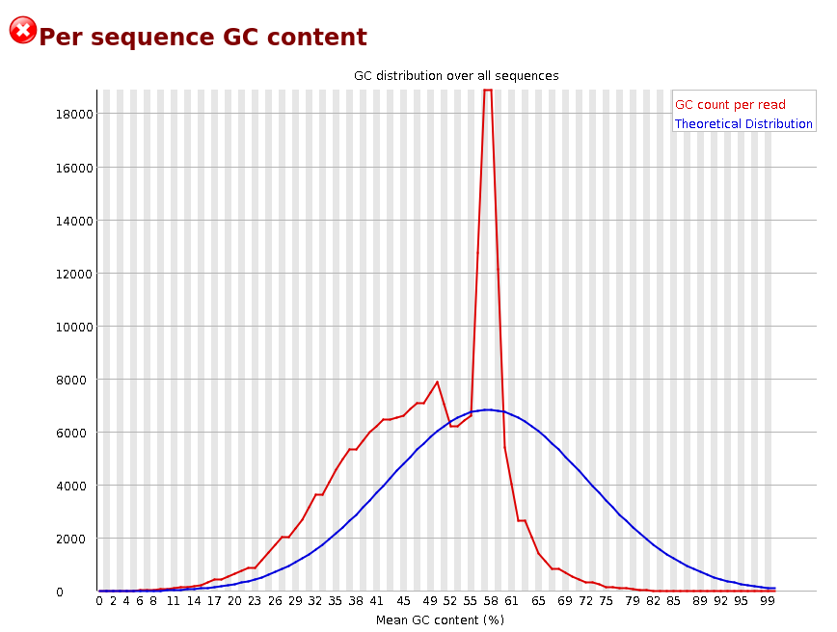
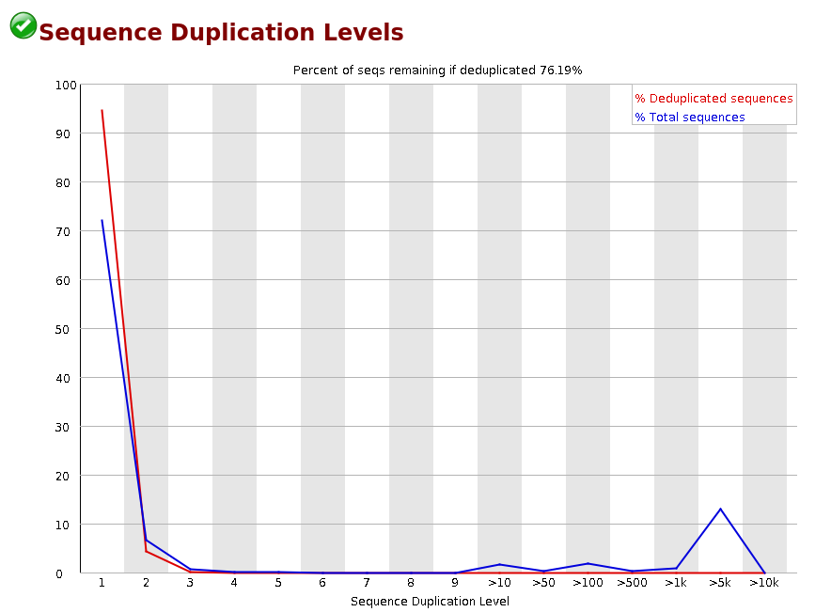
Quality Control. FastQC
An example: Primer dimers
Notes:
fastQC: https://www.bioinformatics.babraham.ac.uk/projects/fastqc/
FastQC checks:
Basic Statistics
Per base sequence quality
Per tile sequence quality
Per sequence quality scores
Per base sequence content
Per sequence GC content
Per base N content
Sequence Length Distribution
Sequence Duplication Levels
Overrepresented sequences
Adapter Content

Slide 24
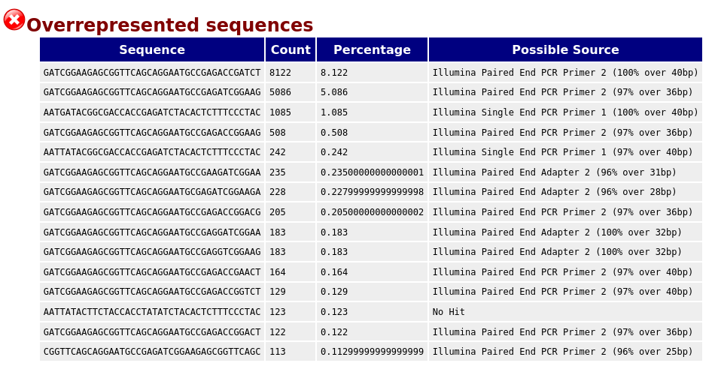
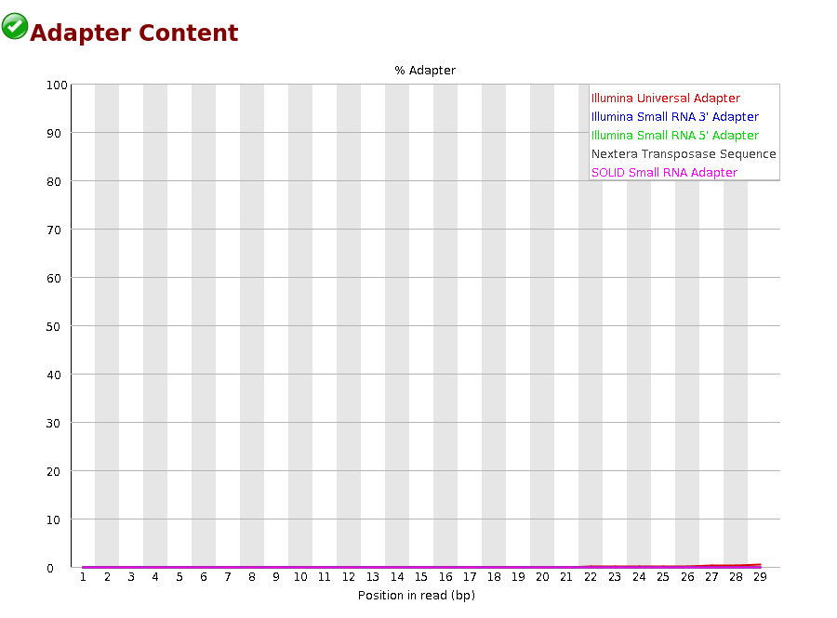
Quality Control. FastQC
An example: Primer dimers
Notes:
fastQC: https://www.bioinformatics.babraham.ac.uk/projects/fastqc/
FastQC checks:
Basic Statistics
Per base sequence quality
Per tile sequence quality
Per sequence quality scores
Per base sequence content
Per sequence GC content
Per base N content
Sequence Length Distribution
Sequence Duplication Levels
Overrepresented sequences
Adapter Content

Slide 25
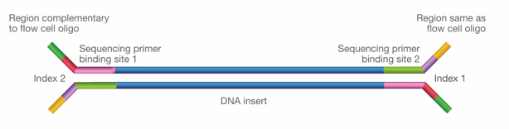
Quality Control. FastQC
An example: Primer dimers – What happened???
Primers can dimerize, i.e. bind to each other instead of the target DNA.
We didn’t get adapters reported because that is the part that pairs with the flowcells. What dimerized in the example were PCR primers.
Notes:
fastQC: https://www.bioinformatics.babraham.ac.uk/projects/fastqc/
FastQC checks:
Basic Statistics
Per base sequence quality
Per tile sequence quality
Per sequence quality scores
Per base sequence content
Per sequence GC content
Per base N content
Sequence Length Distribution
Sequence Duplication Levels
Overrepresented sequences
Adapter Content

Slide 26
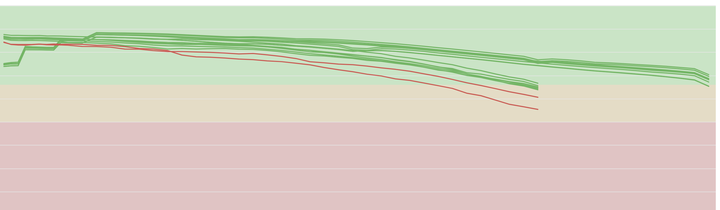
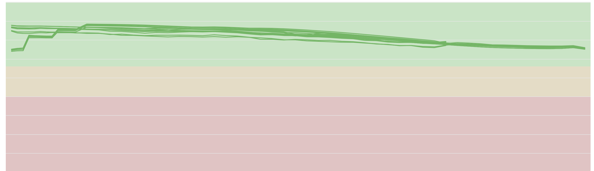
Trimming Read Ends
Mean Quality scores (raw)
Can help to clean your raw sequencing data
Remove:
Adapters
Low-sequencing-quality bases
Poly-A tails
Phred score
Mean Quality scores (trimmed and cleaned)
Tools
CutAdapt
TrimGalore
Trimmomatic
Phred score
Notes:
Trimming to remove adapter sequences (illumine only 3’ end) and low-sequencing-quality bases (5’ end).
Adapters contain the sequencing primer binding sites, the index sequences, and the sites that allow library fragments to attach to the flow cell lawn
The main reason for the decreasing sequence quality is the so-called phasing. Phasing means that the blocker of a nucleotide is not correctly removed after signal detection.
Adapter sequences can be effectively removed by read aligner via ’soft-clipping’ and that many low-sequencing-quality bases, which would be removed by read trimming tools, were rescued by the aligner.
https://academic.oup.com/nargab/article/2/3/lqaa068/5901066

Slide 27

Trimming Read Ends
Trimming only happens from the ends of the reads
You cannot trim poor quality bases in the middle of a read
Another option is to entirely omit these reads

Slide 28
Exercise
In the gitHub repo inside the folder Data/fastqc_examples, you find two fastQC reports. In the group at your table, discuss:
What is bad with this data?
What could you do to clean the data before continuing with the pre-processing?

Slide 29
Workflow
overview
counts table
.fastq
.fasta
Gene ID | Counts
Gene A | 5
Gene B | 3
Gene C | 9
.BAM/.SAM
Sequencer
Produce images
cleaned
trimmed
reads
reference
genome
Aligned
reads
.tsv
CONVERT
to text files
TRIM
reads
ALIGN
to reference

Slide 30
Read Alignment - Traditional mapping
Mapping/alignment is the process of figuring out the most likely origin of a read in a reference genome.
Gene A
Gene B

Slide 31
Read Alignment - Traditional mapping
This is not straightforward:
search space problem
millions/ billions of reads VS large reference (the human genome is 3.2 billion bases)
non-exact matching
Many reads will not match perfectly due to mutations compared to reference and sequencing errors. This complicates finding the best match.
multi mappers (repeat sequences)
If a read cannot be unambigiously assigned, should the program report all possible positions, none or pick one heuristically or randomly?

Slide 32
Read Alignment - Traditional mapping
To solve the search space problem most alignment tools use the "seed and extend" method:
Identify short overlapping sequences between the read and the reference
Extend the match on both sides until the alignment becomes poor
Short exact match
read
ref
Region that matches to the read

Slide 33
Read Alignment - Traditional mapping
To be able to do that, we need to make a dictionary of all short sequences that occur in the reference and where. This is called the index.
A convenient way of creating the index is the Burrows – Wheeler transform (BWT) which both indexes and compresses the reference and enables fast exact matching with low memory requirements.
You can read about the BTW in the original publication:
Heng Li, Richard Durbin; Fast and accurate short read alignment with Burrows-Wheeler transform, Bioinformatics, Volume 25, Issue 14, 2009
Unlike the reads, the reference genome is typically in fasta format:

Slide 34
Fasta format
>mm10_chr1| Chromosome 1 of Mouse genome version 10
CACACACTTTTCTCACACTATTAGGTAACCCTCTGCCTTATTCCACACTTCCTCCATGAT
GTGCTCCCCGTAGTCACAAAGCCAGCTGGAGACAGACTAGAGCAATGAGCCAAAAGTAGA
CCTTTCCTCCTTTTAACTTGACTGTCTTGAATATTCTGGTACAGTAACAGAAATCTGACT
AGCAGGTCCTTGAGTGAATTCCACCTACATGTGGATATGTGTGAGGATAGAGACCTGTTC
Amino acid or nucleotide sequence
Starts with a single line description ”>”,
Reference IDs or descriptions of the sequence, separated by “|”
Usually used for reference genomes, transcriptomes/exomes
Notes:
Human or mouse https://www.gencodegenes.org/

Slide 35
Read Alignment - Traditional mapping
Align to reference genome – RNAseq
In early days we often only mapped to the exome
We are interested in genes or other annotated regions
→ GTF/GFF3 file
Most often it makes sense to align to the newest version of a reference.
Tools:
STAR
Bowtie
BWA
HISAT2
Reference
genome
ATAC
ChIP-seq
CAGE
250 bp
300 bp
350 bp
400 bp
RNAseq
reads
Enhancer?
Genes
A
B
Notes:
STAR: https://hbctraining.github.io/Intro-to-rnaseq-hpc-O2/lessons/03_alignment.html
Bowtie: http://bowtie-bio.sourceforge.net/index.shtml
BWA: http://bio-bwa.sourceforge.net/
ATAC-Seq = Assay for Transposase-Accessible Chromatin with high-throughput sequencing
ChIP Seq = Chromatin immunoprecipitation
CAGE = Cap Analysis of Gene Expression

Slide 36


Sequence Alignment Map - SAM/BAM file
SAM format is a generic format for storing large nucleotide sequence alignments
BAM file is the compressed version → Otherwise the files can be huge!
A SAM file looks like this…
Notes:
Sam file descriptions:
http://samtools.sourceforge.net/
https://samtools.github.io/hts-specs/SAMv1.pdf

Slide 37
SAM format
You can use samtools to interact with alignment data
Header
Reference name of
the mate/next read
Sequence
segment
@HD VN:1.6 SO:coordinate
@SQ SN:ref LN:45
r001 99 mm10_chr1 7 30 8M2I4M1D3M = 37 39 TTAGATAAAGGATACTG *
r002 0 mm10_chr1 9 30 3S6M1P1I4M * 0 0 AAAAGATAAGGATA *
r003 0 mm10_chr2 9 30 5S6M * 0 0 GCCTAAGCTAA * SA,29,-,6H5M,17,0;
r004 0 mm10_chr5 16 30 6M14N5M * 0 0 ATAGCTTCAGC *
r003 2064 mm10_chr2 29 17 6H5M * 0 0 TAGGC * SA:Z,9,+,5S6M,30,1;
r001 147 mm10_chr1 37 30 9M = 7 -39 CAGCGGCAT * NM:i:1
Reference
name
CIGAR string
Query name
Alignment
description
Read
position
FLAG
Template length
Read
quality
Mapping
quality
Position of the
mate/next read
Notes:
QNAME: Query name. Reads having identical are regarded to come from the same template. A QNAME ‘*’ indicates the information is unavailable. In a SAM file, a read may occupy multiple alignment lines, when its alignment is chimeric or when multiple mappings are given.
2. FLAG: Combination of bitwise FLAGs, e.g. paired, aligned, unique, etc.
3. RNAME: Reference sequence NAME of the alignment. If @SQ header lines are present, RNAME (if not ‘*’) must be present in one of the SQ-SN tag. An unmapped segment without coordinate has a ‘*’ at this field. However, an unmapped segment may also have an ordinary coordinate such that it can be placed at a desired position after sorting. If RNAME is ‘*’, no assumptions can be made about POS and CIGAR.
4. POS: 1-based leftmost mapping POSition of the first CIGAR operation that “consumes” a reference base (see table below). The first base in a reference sequence has coordinate 1. POS is set as 0 for an unmapped read without coordinate. If POS is 0, no assumptions can be made about RNAME and CIGAR.
5. MAPQ: mapping Quality. It equals −10 log10 Pr{mapping position is wrong}, rounded to the nearest integer.
6. CIGAR: CIGAR string. Summary of alignment, e.g. match, mismatch, insertion, deletion, reference region skip
7. RNEXT: Reference sequence name of the primary alignment of the NEXT read in the template. For the last read, the next read is the first read in the template. This field is set as ‘*’ when the information is unavailable, and set as ‘=’ if RNEXT is identical RNAME. If not ‘=’ and the next read in the template has one primary mapping (see also bit 0x100 in FLAG), this field is identical to RNAME at the primary line of the next read. If RNEXT is ‘*’, no assumptions can be made on PNEXT and bit 0x20.
8. PNEXT: 1-based Position of the primary alignment of the NEXT read in the template. Set as 0 when the information is unavailable. This field equals POS at the primary line of the next read. If PNEXT is 0, no assumptions can be made on RNEXT and bit 0x20.
9. TLEN: the number of bases covered by the reads form the same fragment. + = leftmost read, - = rightmost read
10. SEQ: read sequence. This field can be a ‘*’ when the read is not stored.
11. QUAL: A base quality is the phred-scaled base error probability which equals −10 log10 Pr{base is wrong}. Read quality * means this information is not available.

Slide 38
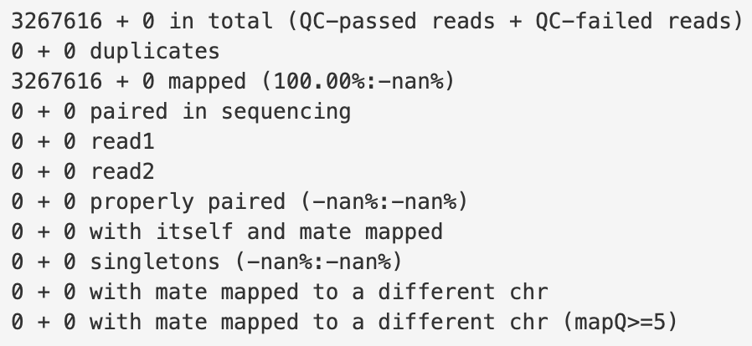
Samtools flagstat
Samtools flagstat will check your sam/bam files and give you general information about the aligned reads.
Notes:
Samtools flagstat: http://www.htslib.org/doc/samtools-flagstat.html

Slide 39
Workflow
overview
counts table
Gene ID | Counts
Gene A | 5
Gene B | 3
Gene C | 9
Sequencer
Produce images
.tsv
CONVERT
to text files
TRIM
reads
ALIGN
to reference
REMOVE
duplicates*
*might not be recommended → see in next slides

Slide 40
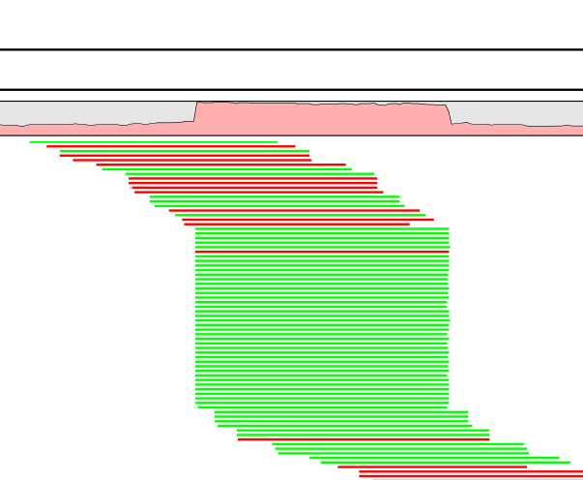
To Remove Duplicates or Not?
Copies of the same template DNA binds to different beads in a flowcell
Ribosomal house keeping genes
PCR preferentially enriches smaller and more GC-poor molecules
Over amplification
Low library complexity
30% or less just fine, no need to remove
Duplicates
Tools:
MarkDuplicates
Samtools
Notes:
The lower your ratio of unique molecules to beads, the more PCR duplicates you will have, even before your ratio begins to approach 1.0, where PCR duplicates would be required in order to saturate the beads with DNA molecules
Even with 64 copies each of the unique molecules, PCR duplicates are very rare by pure chance. Each unique molecule’s chance of getting represented even once (let alone twice) is small.

Slide 41
To Remove Duplicates or Not?
Genome browser visualization
Sequencer
Produce images
VISUALISE
reads per bin
CONVERT
to text files
TRIM
reads
ALIGN
to reference
REMOVE
duplicates*
QUANTIFY
reads per region

Slide 42
Workflow
overview
counts table
Gene ID | Counts
Gene A | 5
Gene B | 3
Gene C | 9
Sequencer
Produce images
.tsv
CONVERT
to text files
TRIM
reads
ALIGN
to reference
REMOVE
duplicates*
QUANTIFY
reads per region

Slide 43
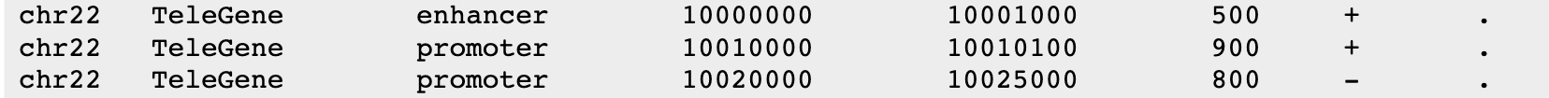
GFF/GTF formats
General Feature Format (GFF3). Tab separated file
Contains genomic features: promoter, enhancer, exon, gene, etc.
Column 9 contains attributes: gene id, gene name, transcript id, etc.
Gene Transfer Format (GTF). Pretty much the same
seqid
feature
end
strand
source
start
score
frame
ID=ENSMUSG00000102693.2;gene_id=ENSMUSG00000102693.2;gene_type=TEC;gene_name=4933401J01Rik;
level=2;mgi_id=MGI:1918292;havana_gene=OTTMUSG00000049935.1
gene_id "ENSMUSG00000102693.2"; gene_type "TEC"; gene_name "4933401J01Rik";
level 2; mgi_id "MGI:1918292"; havana_gene "OTTMUSG00000049935.1"
Notes:
GFF3: https://www.ncbi.nlm.nih.gov/datasets/docs/v1/reference-docs/file-formats/about-ncbi-gff3/
seqname - The name of the sequence. Must be a chromosome or scaffold.
source - The program that generated this feature.
feature - The name of this type of feature. Some examples of standard feature types are "CDS" "start_codon" "stop_codon" and "exon"li>
start - The starting position of the feature in the sequence. The first base is numbered 1.
end - The ending position of the feature (inclusive).
score - Currently only provided for alignments, if they contain a score named “score”. The definition of this score may vary depending on the type of alignment.
strand - Valid entries include "+", "-", or "." (for don't know/don't care).
phase - If the feature is a coding exon, frame should be a number between 0-2 that represents the reading frame of the first base. If the feature is not a coding exon, the value should be ".".
attributes - All lines with the same group are linked together into a single item.

Slide 44
Read count tables
Tools:
STAR
HISAT2
bedtools
Rsubread
Most of times is this the end goal!
Matrix of read counts per gene or per genomic region
bam file reads
Reference
sequence
100 bp
150 bp
200 bp
250 bp
300 bp
350 bp
400 bp
Gene/Transcript | Counts
A | 5
B | 3
C | 9
A
B
C
Genes/Transcripts (GTF/GFF)
Notes:
Bedtools: https://bedtools.readthedocs.io/en/latest/
STAR aligner: https://hbctraining.github.io/Intro-to-rnaseq-hpc-O2/lessons/03_alignment.html
Star aligner can do read count tables with the “--quantMode GeneCounts” option
Rsubread: https://bioconductor.org/packages/release/bioc/html/Rsubread.html

Slide 45
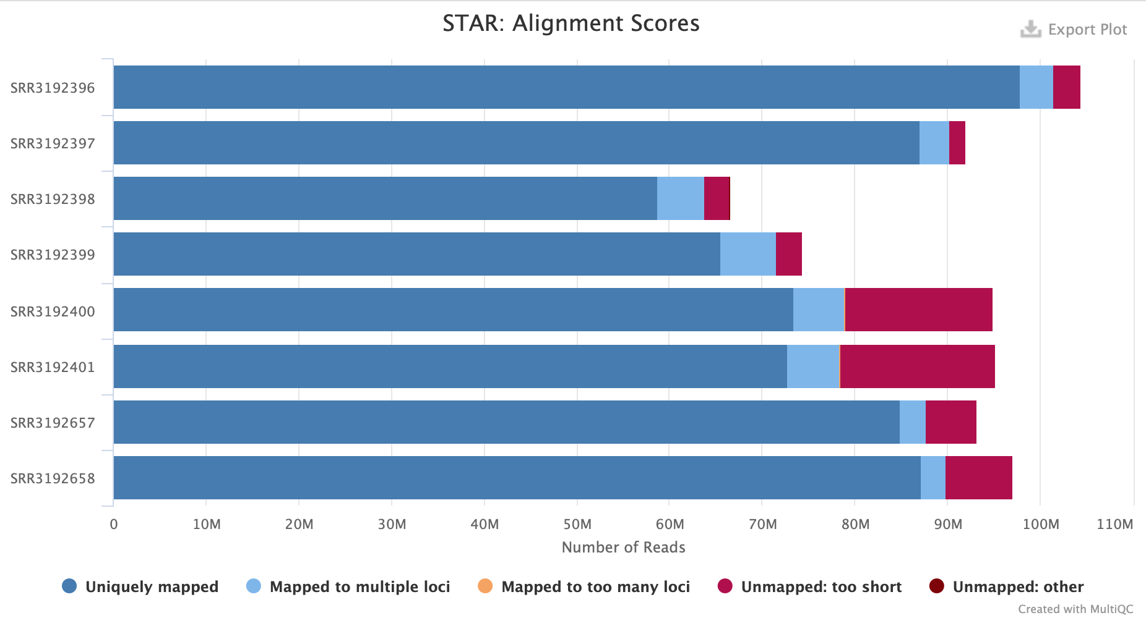
Workflow
overview
Quality control check: MultiQC report
Workflow
Sequencer
Produce images
.fastq
.SAM/.BAM
.SAM/.BAM
.tsv
CONVERT
to text files
TRIM
reads
ALIGN
to reference
REMOVE
duplicates*
QUANTIFY
reads per region

Slide 46
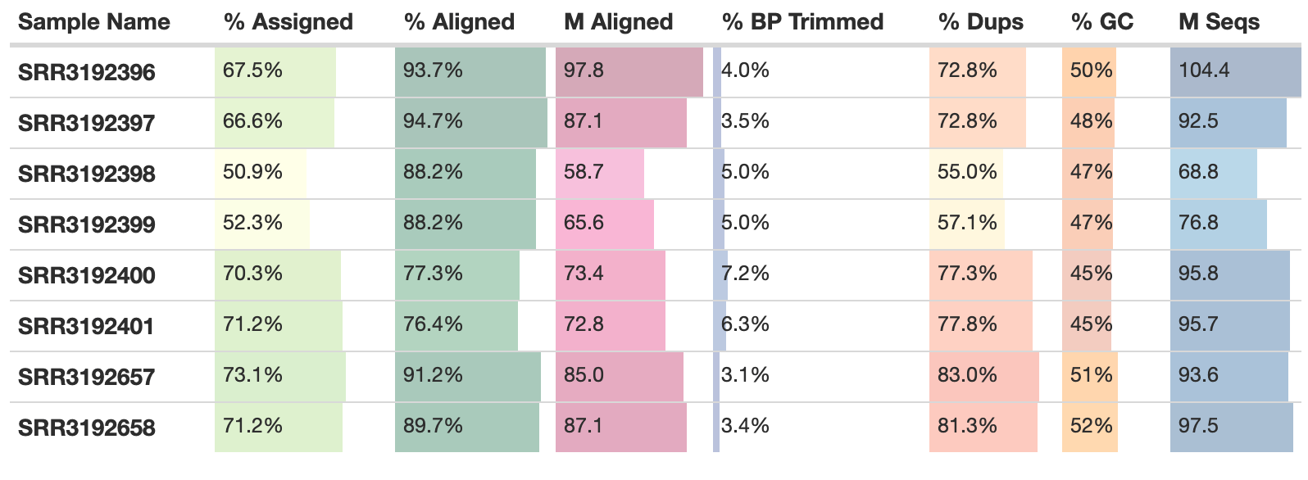
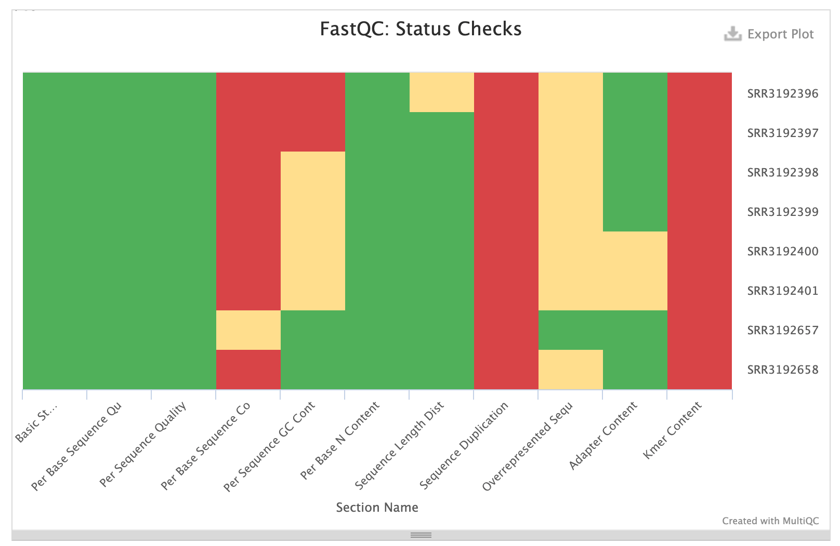
MultiQC reports
Summarises all kinds of reports:
FastQC
Trimming
Alignment
Feature counts
Differential Expression
Notes:
MultiQC: https://multiqc.info/

Slide 47
Pseudoalignment & Quantification
Alignment and quantification in one step
4 x faster than the fastest regular alignment tools
Memory usage ~ 10 x lower
Easy to use! Download their data and calculate your count matrices
Precomputed indexes for several species:
Human
Mouse
Tools:
Salmon
Kallisto
Bray, Nicolas L., et al. "Near-optimal probabilistic RNA-seq quantification." Nature biotechnology 34.5 (2016): 525-527.
https://tinyheero.github.io/2015/09/02/pseudoalignments-kallisto.html
Kallisto
Notes:
An example of a read (in black) and three overlapping transcripts with exonic regions as shown.
An index is constructed by creating the transcriptome de Bruijn Graph (T-DBG). Each node is a k-mer in the T-DBG and is associated with a transcript or set of transcripts which is formally described in the paper as a k-compatibility class. In this example, the left most node has a k-compatibility class of all 3 transcripts.
Kallisto will store a hash table mapping each node to the contig (linear stretches; e.g. the first 3 nodes) it is contained in, along with the position within the contig. This structure is called the “kallisto index”.
To find the transcript(s) a read is compatible with, we take the intersection of all k-compatibility classes that a read is associated with; This is formally described as the k-compatibility class of a read.
The k-compatibility class of the read is determined by taking the intersection of the k-compatibility classes of its constituent k-mers.
Skipping (black dashed lines) uses the information stored in the T-DBG to skip k-mers that are redundant because they have the same k-compatibility class (This is classified as having the same “equivalence class”).

Slide 48
Workflow
overview
Reference genome
fasta file
Genome browser visualization
Sequencer
“raw” reads
Cleaned and trimmed reads
Aligned reads
BigWig file
fastq file
fastq file
BAM/SAM file
Remove duplicated reads
Read count table
Quality control check
Gene/Region | Counts
A | 5
B | 3
C | 9
SAM file
MultiQC report

Slide 49
pipelines
Summarised Workflow
Bioinformatics community for curated pipelines
Completely reproducible, following gold standards and easy to implement
More and more pipelines are being introduced and updated
Bulk RNAseq
Single Cell RNAseq
ATACseq
ChIPseq
HICseq
https://nf-co.re/pipelines
Notes:
https://nf-co.re/pipelines

Slide 50
Workflow
overview
Workflow
Reference genome
fasta file
Genome browser visualization
Sequencer
“raw” reads
Cleaned and trimmed reads
Aligned reads
BigWig file
fastq file
fastq file
SAM file
Remove duplicated reads
Read count table
Quality control check
Gene/Region | Counts
A | 5
B | 3
C | 9
SAM file
MultiQC report

Slide 51
Perhaps a slide on pipelines?

